Slide 1
BAS 475 -
Final Group Presentation
David Carlton, Scott Martin,
Taylor Britt, Peyton Wells

Slide 2
Data Description
The Dataset:
Steadily increasing, monthly credit amount
Goal:
Accurately predict monthly Imperial Credits
Provide predictions for the next 12 periods

Slide 3
Data Preparation
In order to accurately model and test the forecasts that we created, we will split our data into two sets:
Training Data, contains Months: 1 through 480
Holdout Data, contains Months: 480 through 492
This allows us to make predictions based on the training data and then test the accuracy against the holdout data

Slide 4
Cross Validation
Technique by which data is provided to the model incrementally and the accuracy of the predictions are tested along the way
(CV) ensures that the model we create is not ‘overfit’ in that it will accurately predict into the future
Parameters for CV
Initial data = 48 (# of periods of data that the model uses to create first predictions)
Step Length = 24 (# of periods of data that the model is incrementally fed to build off of and check for accuracy)

Slide 5
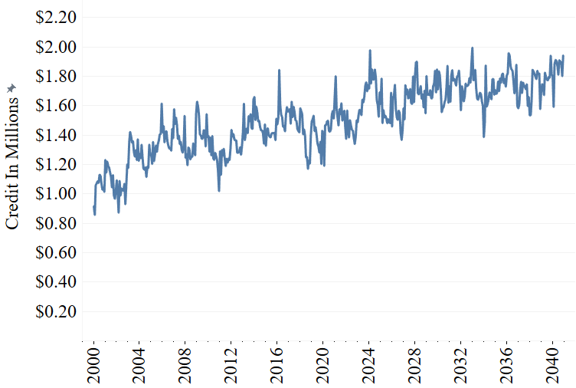
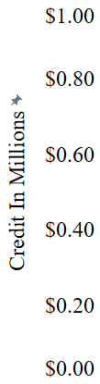
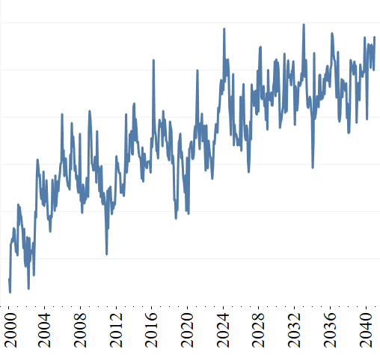
Transformations
Shows minimal change – deemed unnecessary
No Transformation
Box-Cox using optimized lambda

Slide 6
Models
Stepwise- Uses the elimination and addition of explanatory variables to build a model
Search- Searches all model variations to find the best one for the data
NeuralNet- Uses a series of neurons, or calculation pathways, to make predictions based on inputs
ARIMA210- Uses past forecasts to predict future forecasts
ARIMA013- Uses the errors, or how far off the prediction was, to predict future forecasts
Exponential Smoothing- Uses exponentially decreasing weights the further back a past observation goes

Slide 7
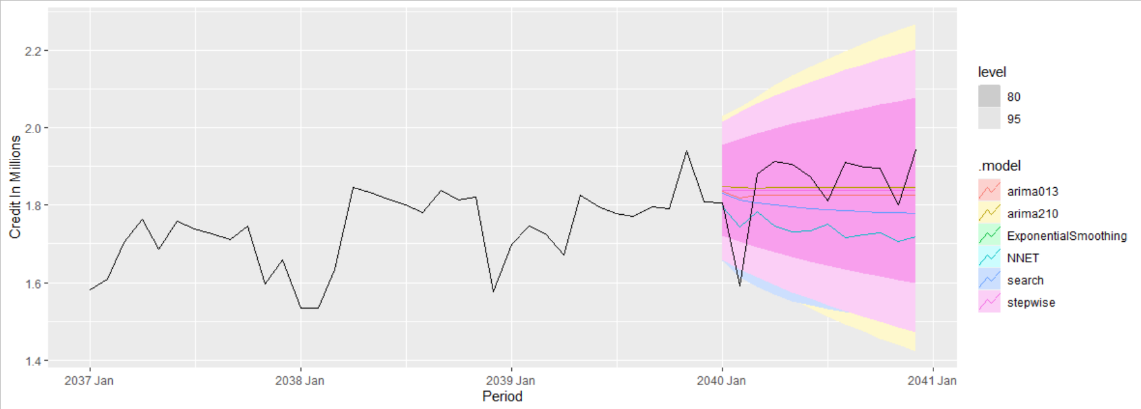
Forecasts (based on last 48 months)

Slide 8
Metric Definitions
RMSE (Root Mean Square Error) - Shows the error of a model by squaring it first so positive and negative errors don’t cancel each other out
Weighs large errors more heavily
MAE (Mean Absolute Error) - Takes the average absolute values of errors
Weights all errors the same
MAPE (Mean Absolute Percentage- Returns a value relative to the dataset
Easier to understand
Compared across datasets since it is a relative value

Slide 9
Model Comparison Chart
Model | RMSE | MAE | MAPE
Stepwise | 0.1280 | 0.10400 | 7.070
Exponential Smoothing | 0.1300 | 0.10700 | 7.260
Search | 0.1320 | 0.10700 | 7.290
Arima 210 | 0.1340 | 0.11000 | 7.500
Arima 013 | 0.1400 | 0.11300 | 7.760
Neural Net | 0.2380 | 0.15000 | 10.100

Slide 10
Recommendations
In order to rescue and return our brave Imperial Analytics team from the dastardly rebels, we recommend the stepwise function because gives a smaller range, ensuring that our preparations are more focused and efficient
We recommend using the stepwise model, given that it produces an RMSE lower than the other five models tested

Slide 11

Predictions for next 12 months credit balance
Period # | Predicted Credit Balance (in Millions)
1 | 1.908
2 | 1.911
3 | 1.913
4 | 1.915
5 | 1.918
6 | 1.920
7 | 1.922
8 | 1.925
9 | 1.927
10 | 1.929
11 | 1.932
12 | 1.934

Slide 12
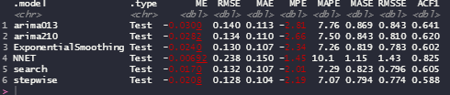
Index

Slide 13

Godspeed soldiers and bring back our analytics team!

